Slide 1
ARTIFICIAL INTELLIGENCE AND JOBS
Report by- AKSHADA MALPURE
Seminar guide- prof. hitendra khairnar
ROLL NO: 3934

Slide 2
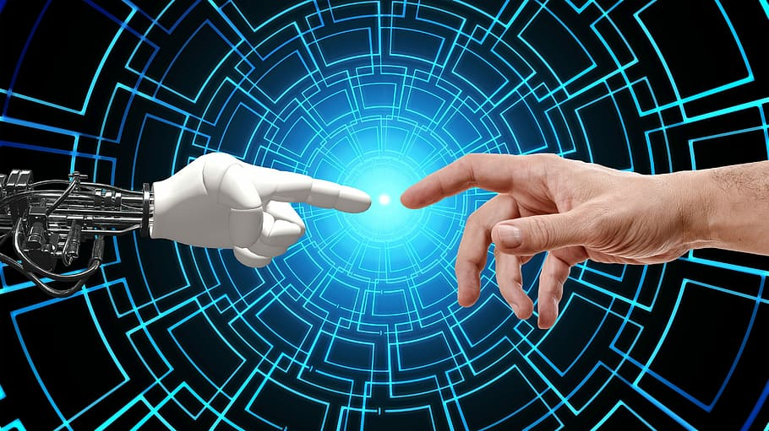
ABSTRACT
The concept of Artificial Intelligence has attracted a lot many scholars round the globe and is the most trending and widely used technology these days.
Artificial Intelligence has promoted the transformation and upgradation of economy and society but simultaneously had an adverse effect on the employment structure. It has already automated many jobs and continues to do so, but the end result on the employments remain uncertain and vary according to the industry and demand.
In this report we will see the impact of Artificial Intelligence on employment, its counter measures along with a case study of job-hopping pattern based on artificial intelligence.

Slide 3

Contents
Chapter 1- Introduction
Chapter II- The Impact of Artificial Intelligence on Employment
Chapter III- The Countermeasures to the Impact of AI on Employment
Chapter IV- Analysis of current situation of industrial Development due to AI
Chapter V- Sequential Optimization of Naive Bayesian (SONB)
Chapter VI- Conclusion
This Photo by Unknown Author is licensed under CC BY-SA

Slide 4
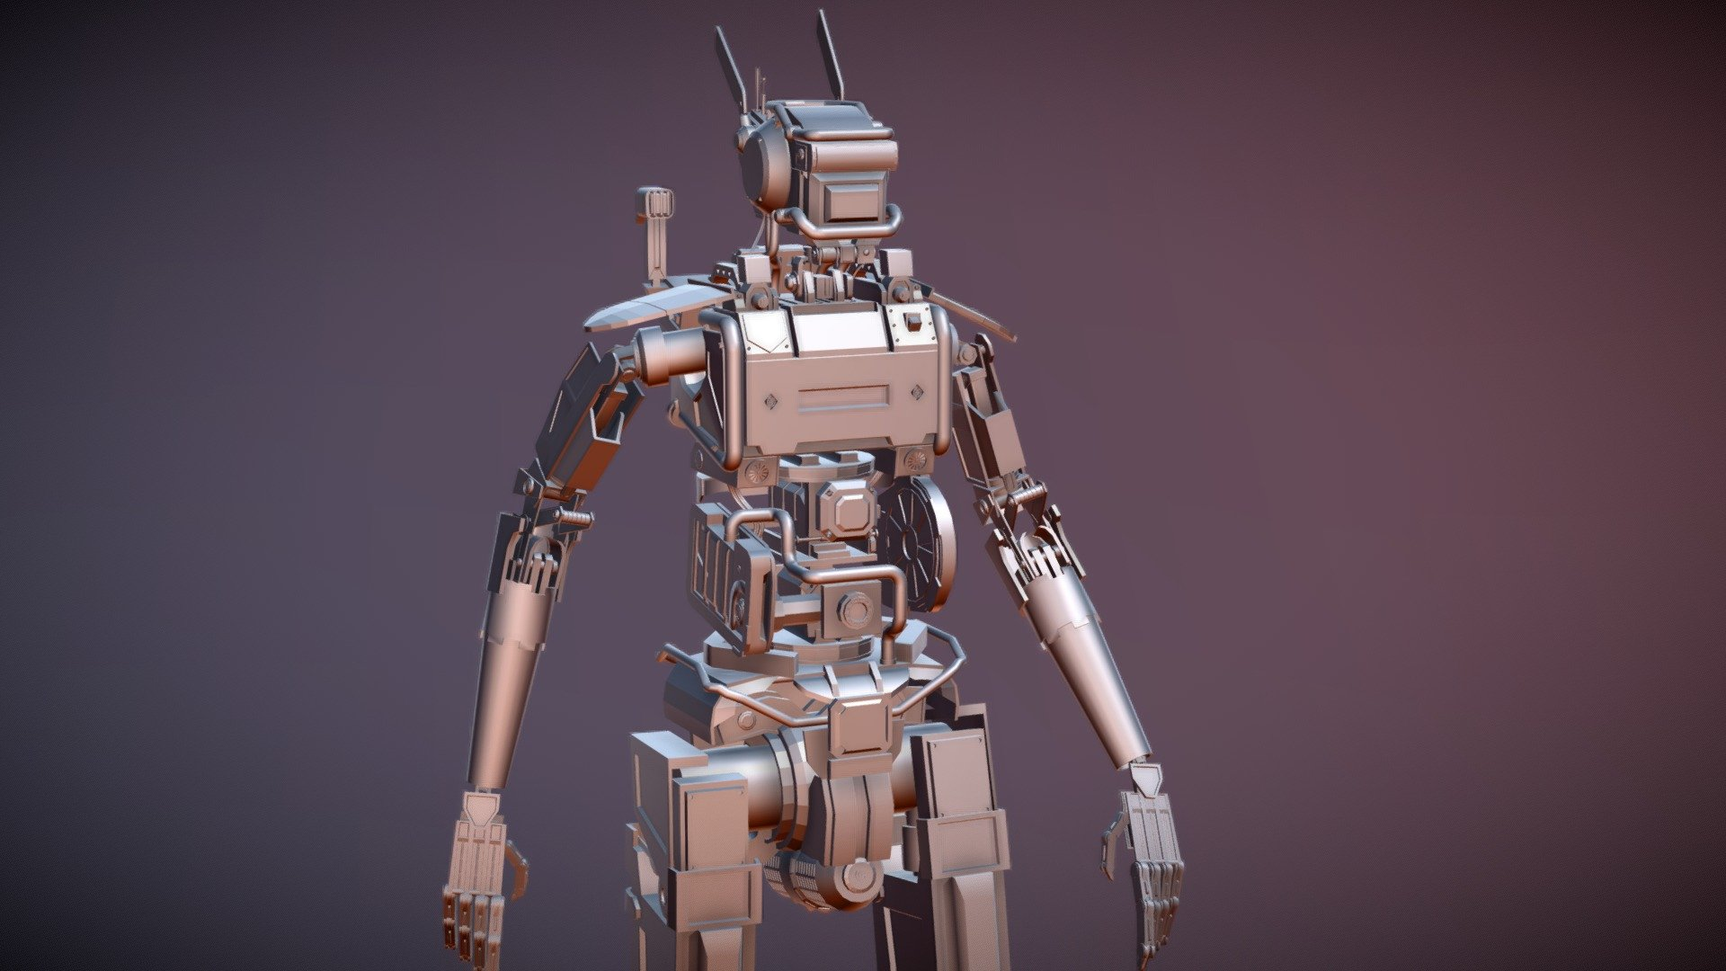
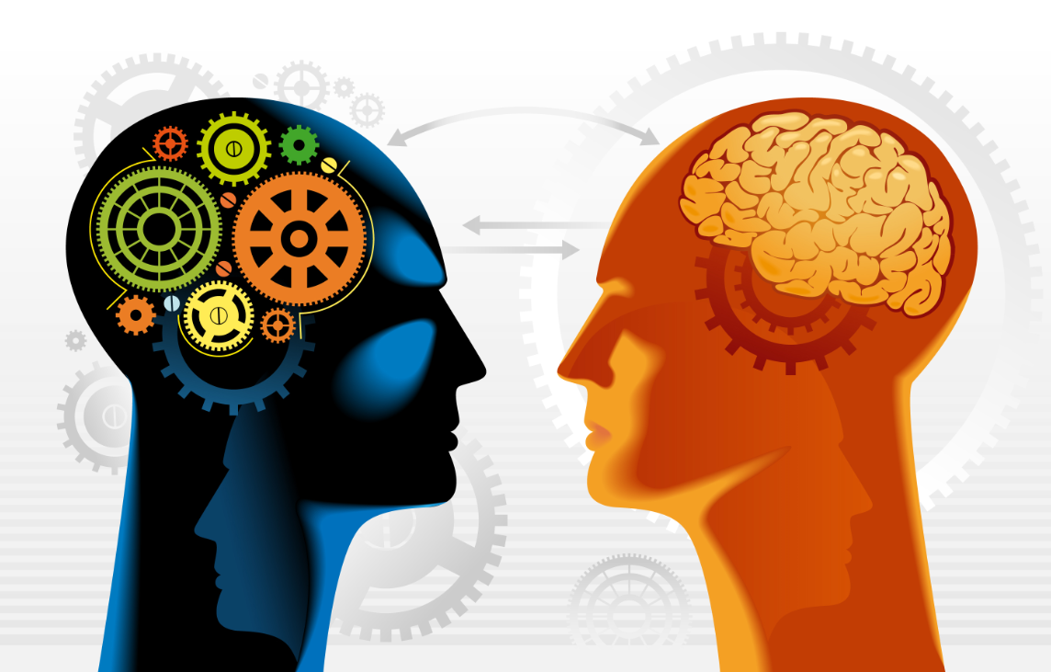

Chapter 1- introduction to artificial intelligence
Artificial Intelligence is the branch of computer science which gains intelligence and attempts to perform actions like a human.
It is very versatile and covers a wider range of industries in people’s employment. Many of the companies have even faced a situation of being majorly replaced by artificial intelligence.
Besides it impacts on employment, artificial intelligence technology is used in the selection of the company hiring or recruitment process itself.

Slide 5

Chapter 1- the development of artificial intelligence
1956- Dartmouth Conference -the concept of artificial intelligence was proposed
1960- lack of hardware and algorithmic defects, development did not flourish
1970- research of backpropagation started
1980-research on algorithms based on AI began to advance rapidly, development of Internet reduced computing cost and development had no bounds
2006- deep learning was proposed, AI achieved breakthrough development
21st century- mobile internet brought more application scenarios for AI
2012- deep learning achieved high levels in speech and visual recognition

Slide 6
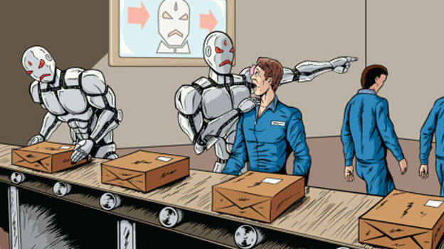
Chapter ii- The impact of Artificial intelligence on employment
The Substitution Effects of Artificial Intelligence on Employment
Artificial Intelligence is widely used in various fields, from medical care to customized education, from more efficient retail and manufacturing to autonomous vehicles.
It has been predicted that in coming years, 5 million jobs will be replaced by machines. This rate would go even higher in near future.
This so-called technological unemployment is the unemployment caused by technological progress.
Many single-skilled occupations, cumbersome labor, especially some procedural, routine jobs or precision jobs that cannot be handled manually may be replaced by machines.
Not all jobs have been replaced by artificial intelligence.

Slide 7

Chapter ii- The impact of Artificial intelligence on employment
The Creative Effects on Artificial Intelligence on Employment
The high application of artificial intelligence will improve the quality of human life and change the living style.
The use of new technology will not only improve work efficiency and promote the development of productivity, but will also have a decisive impact on labor and employment.
Rather than working on the tedious job of handling machines, humans can better focus on some other creative work which only humans can do.
The development of artificial intelligence has caused new business paradigms and new business formats in the form of employment, which will lead to new forms of employment, which will significantly increase the proportion of flexible employment in the society.

Slide 8

Chapter ii- The impact of Artificial intelligence on employment
The Polarization Effects of Artificial Intelligence on Employment
Many international scholars believe that the employment structure of the labor force is showing a polarizing trend.
What is the reason for this polarization?
Nature of work- AI replacing repetitive work which are concentrated in middle income jobs.
The substitution has squeezed middle income workers, either to high or low income.
Technological progress has also created a direct demand for highly skilled labor, which has resulted in a polarization effect on employment.

Slide 9

Chapter iii- THE COUNTERMEASURES TO THE IMPACT OF ARTIFICIAL INTELLIGENCE ON EMPLOYMENT
Narrowing the Substitution Effects of Artificial Intelligence on Employment
The entrepreneurial spirit in today's competitive world has become a ride of adventures and the personal characteristics of the entrepreneurs, with an ambition to break through the obstinacy of existing technology, diligently supply premium services by correctly incorporating industry chain, added product value with ample options of types to increase position and promote levels of employment.
On the contrary, it is essential to upgrade the quality and ability of works and workers with the establishment of a professional education system and skill training.

Slide 10
Chapter iii- THE COUNTERMEASURES TO THE IMPACT OF ARTIFICIAL INTELLIGENCE ON EMPLOYMENT
Amplifying the Creative Effects of Artificial Intelligence on Employment
We should increase the pre-judgement of the applications of artificial intelligence technology and promote the it in a planned and organized manner.
Within the overall framework full play to market functions and reorganization and rebuilding of jobs must be done.
Respect the law of industrial revolution, give focus on the upgrading and application of artificial intelligence.
With the help of artificial intelligence, we must try to improve the urban development planning and provide incubation and accelerated development guarantees for artificial intelligence in space.
Most importantly we must encourage and support the transfer of labor to the new form of artificial intelligence.

Slide 11

Chapter iii- THE COUNTERMEASURES TO THE IMPACT OF ARTIFICIAL INTELLIGENCE ON EMPLOYMENT
Cultivate Professionals in Artificial Intelligence
We must actively building platforms to strengthen the introduction and training of artificial intelligence talents.
We must utilize the industrial platforms, encourage school-enterprise cooperation, support relevant universities to strengthen the construction of artificial intelligence- related disciplines.
Also, in schools which support vocational structure, courses must be provided for the growth of artificial intelligence and the skills urgently needed by the industry.

Slide 12
Chapter iii- THE COUNTERMEASURES TO THE IMPACT OF ARTIFICIAL INTELLIGENCE ON EMPLOYMENT
Play the Role of Market Regulation Mechanism
It is necessary to use both tangible and intangible hands to maintain sufficient flexibility in the labor employment system and labor market.
The government should attach importance to and take active measures to carry out macro-control, encourage workers to maintain professional vitality, and use various forms to realize reemployment.
Workers must change their employment concepts, and strive to continuously improve their own qualities through hard work to learn scientific and cultural knowledge and vocational technology, and reduce the risk of permanent unemployment.

Slide 13
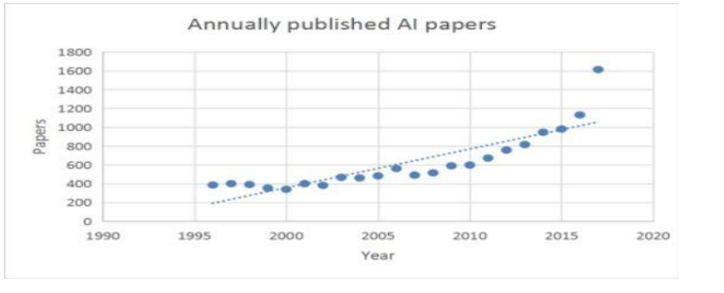
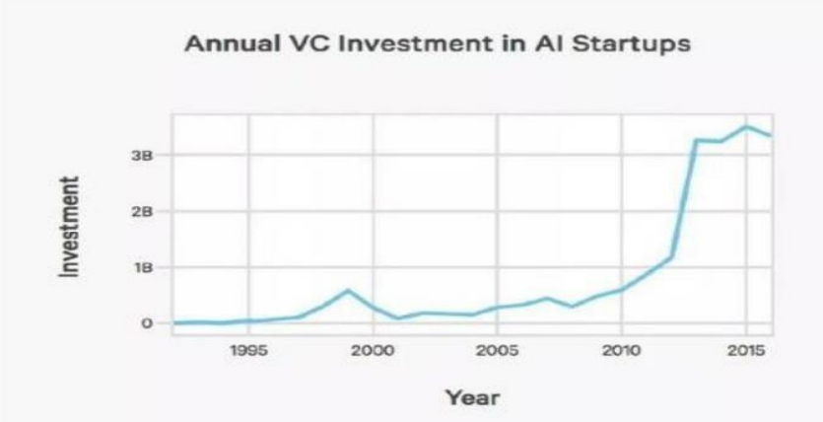
Chapter iv-ANALYSIS OF THE CURRENT SITUATION OF INDUSTRAIL DEVELOPMENT DUE TO AI
The Number of AI research papers increased by 400%
In the accompanying 20 years, the quantity of AI papers has expanded fundamentally, expanding to more than 400%. The fast expansion in the quantity of scholar research papers demonstrates that the quantity of new educated property freedoms and licenses has likewise progressed by leaps and bounds.
The AI Venture Capital has surged 6 times since 2000
The fast expansion in how much speculation shows that investor (VC) has a firm trust in the improvement of AI new businesses and are incredibly hopeful about their advancement possibilities.

Slide 14
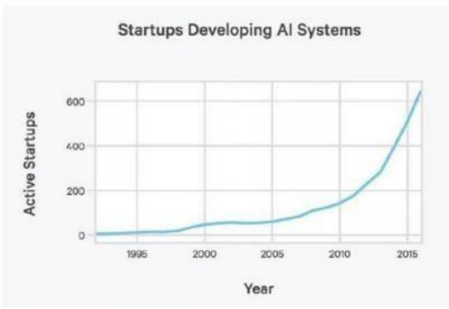
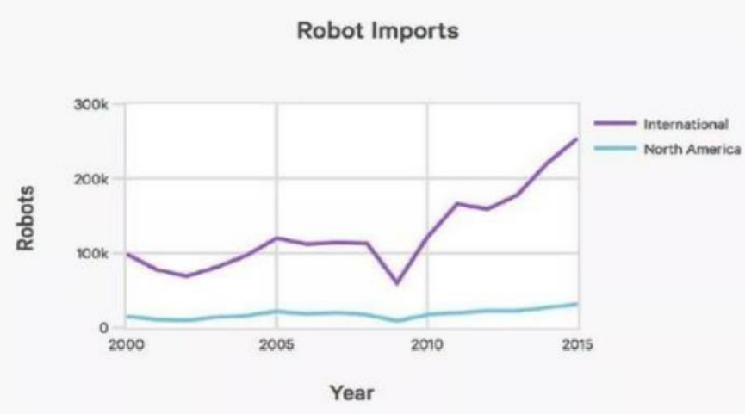
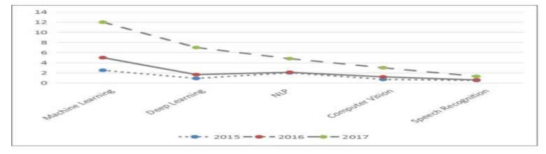
Chapter iv-ANALYSIS OF THE CURRENT SITUATION OF INDUSTRAIL DEVELOPMENT DUE TO AI
AI Start-Ups Surge 14 times
New AI Application Skills Become the Core Skills of Job Search
The Number of Robot Imports Has Increased to 2.5 Times

Slide 15
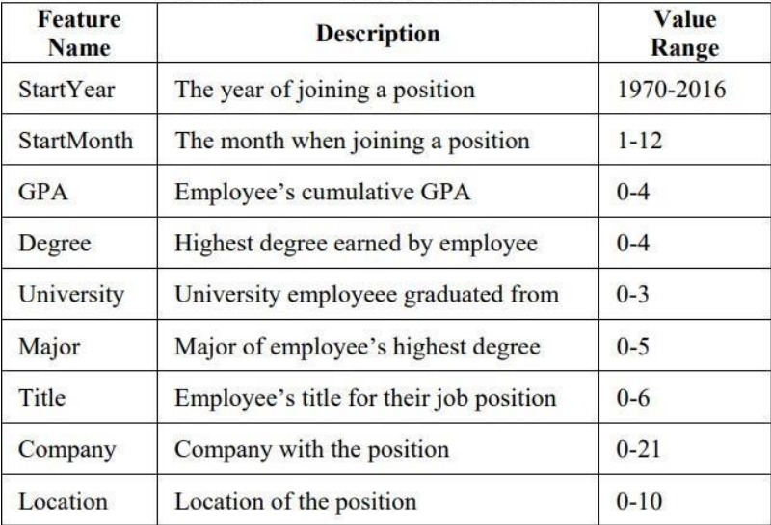
Chapter v- SEQUENTIAL OPTIMIZATION NAIVE BAYESIAN
A Case Study where using Artificial Intelligence
we have found out the job-hopping pattern.
Data pre-processing- Train and Test 70:30
Missing values replaced by 0.
Feature Calculation:

Slide 16
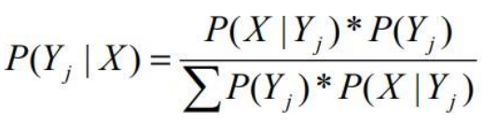
Chapter v- SEQUENTIAL OPTIMIZATION NAIVE BAYESIAN
In the Bayesian theory, it introduces a way to calculate the posterior probability by using the prior probability and overall likelihood:
The machine learning algorithm learns function f to map X to Y, class Yj predicts whose probability is maximum compared to other classes
Suppose there exists feature values in X that are missing or not reliable, which were considered as 0. SONB sequentially optimizes each feature value before making any predictions.
Now all the data has been cleaned SONB uses the Naïve Bayesian algorithm to train a model.
Accuracy Evaluation- we calculate the absolute difference of the predicted and real total months of employee staying in a position.

Slide 17
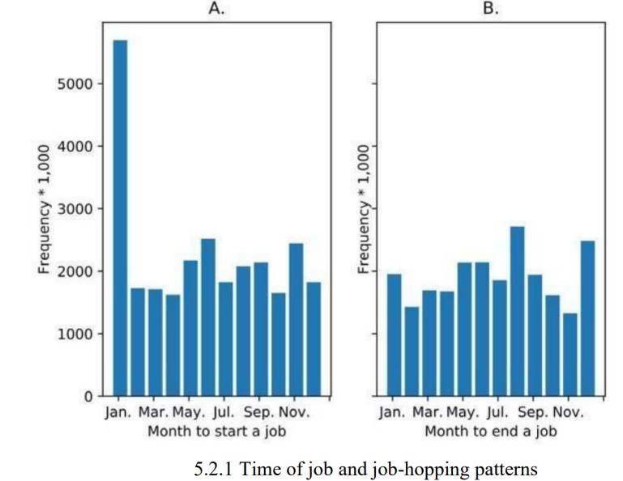
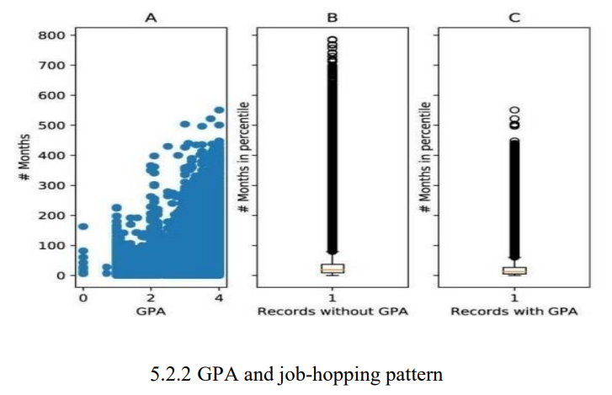
Chapter v- SEQUENTIAL OPTIMIZATION NAIVE BAYESIAN

Slide 18
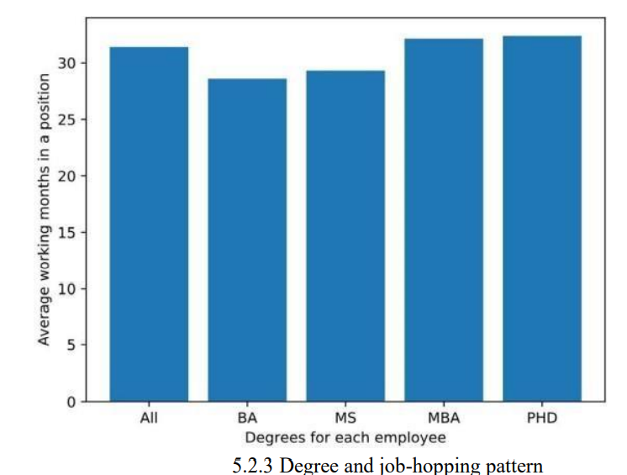
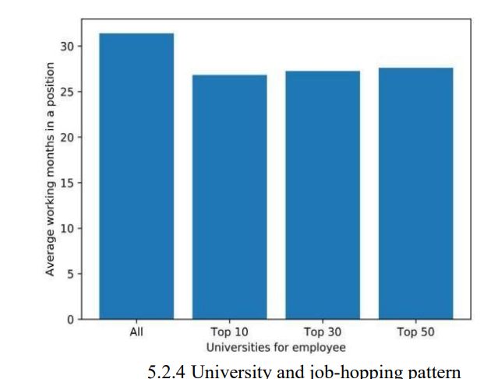
Chapter v- SEQUENTIAL OPTIMIZATION NAIVE BAYESIAN

Slide 19
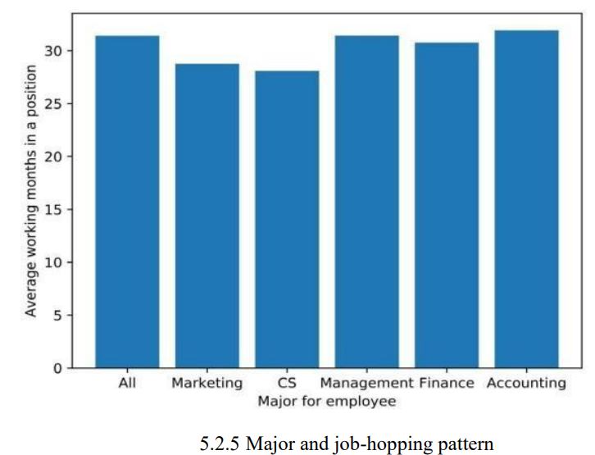
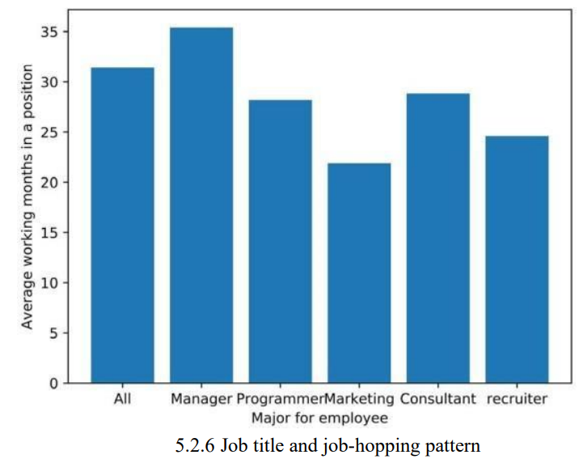
Chapter v- SEQUENTIAL OPTIMIZATION NAIVE BAYESIAN

Slide 20
Chapter 6- conclusion
As of now, it can supplant a portion of the more hazardous and monotonous physical work.
won't totally supplant human business, and will help out people, so laborers can zero in more on scholarly work.
the enterprises it drives will likewise make an enormous number of new positions for individuals, like the help business and more imaginative positions.
Individuals need to further develop their insight stores and advancement capacities, and apply creative reasoning to their work
Better adjust to new business strategies in the new climate

Slide 21
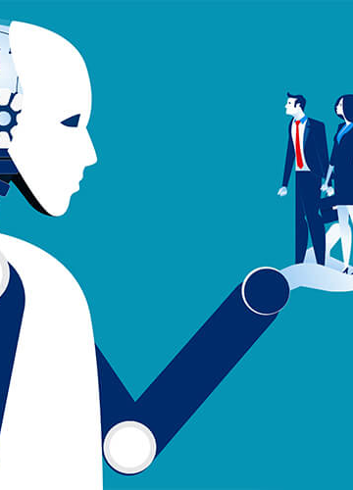
Thank you

